Slide 1



Universities as Catalysts for Thriving Communities and a Healthier Planet
Dr. Sharon Jae Hall
Associate Dean & President’s Professor

Slide 2

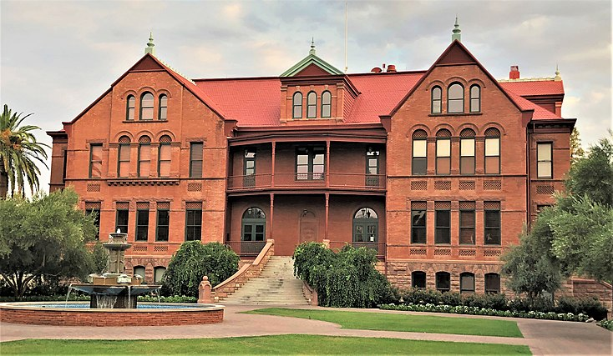
Higher education is struggling to meet the urgent needs of society
in a rapidly changing world
Faculty skills and culture don’t often meet the needs of communities and industry
Institutional structure is complicated and processes are slow
Tertiary education is still not accessible to most people

Slide 3
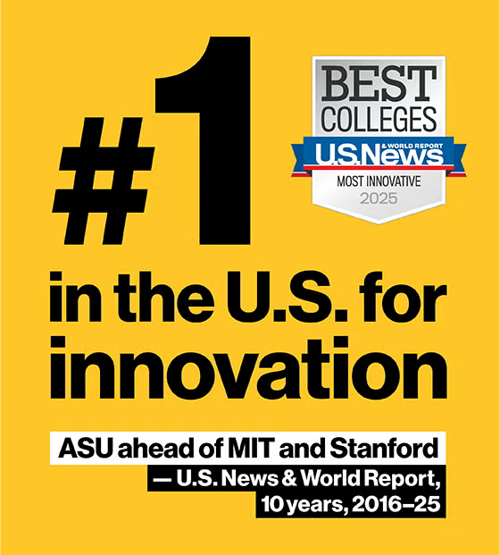
Using ASU as a case study for university innovation in sustainability and impact
Durable mission and leadership
Building faculty as knowledge entrepreneurs
Adapting university structures for urgent societal needs
10 yrs, 2016-25

Slide 4
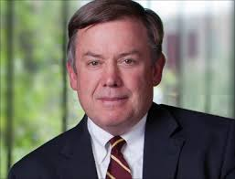
Durable mission and leadership
The Charter of the New American University
ASU is a comprehensive public research university, measured not by whom it excludes, but by whom it includes and how they succeed; advancing research and discovery of public value; and assuming fundamental responsibility for the economic, social, cultural, and overall health of the communities it serves.
Michael Crow
Named 2024 Time 100 Climate Innovator

Slide 5
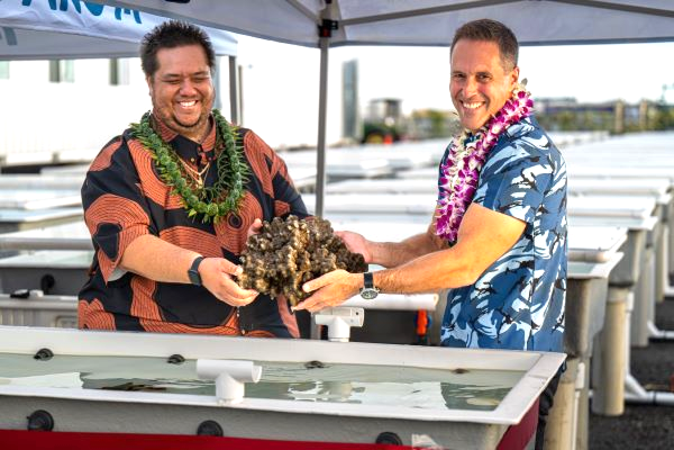
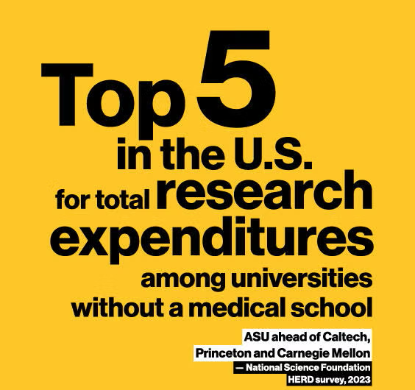
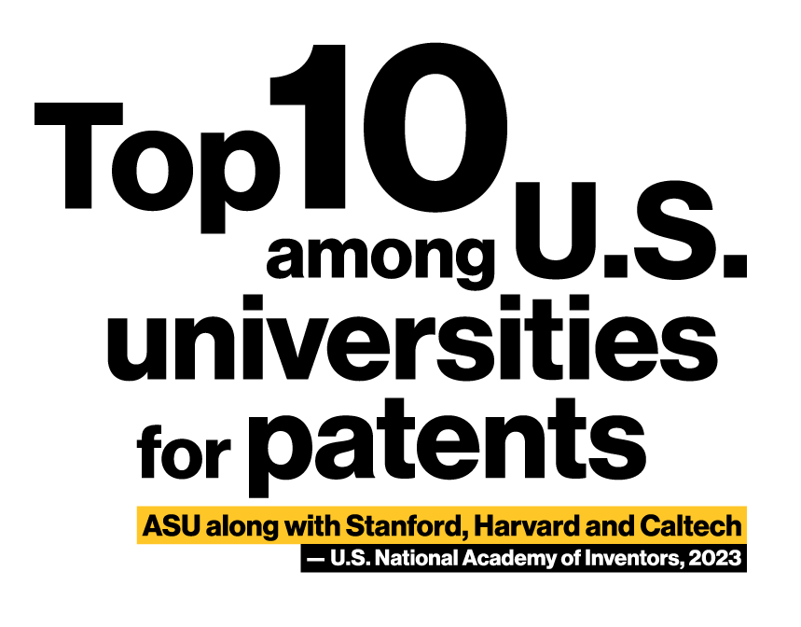
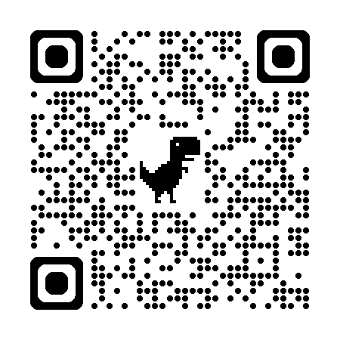
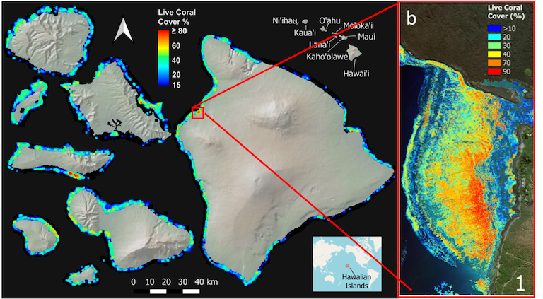
ASU is a comprehensive public research university, advancing research and discovery of public value….
$992 million
Annual research expenditures, 2024
Dr. Greg Asner and community partners
Center for Global Discovery and Conservation

Slide 6
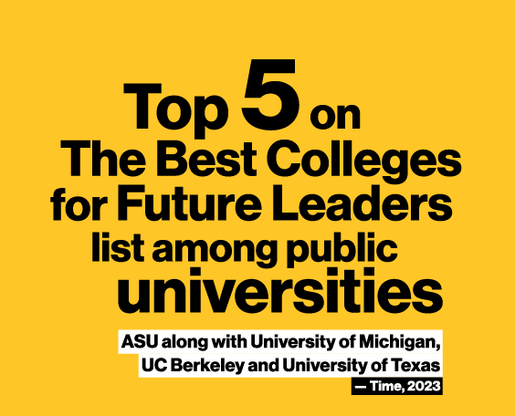
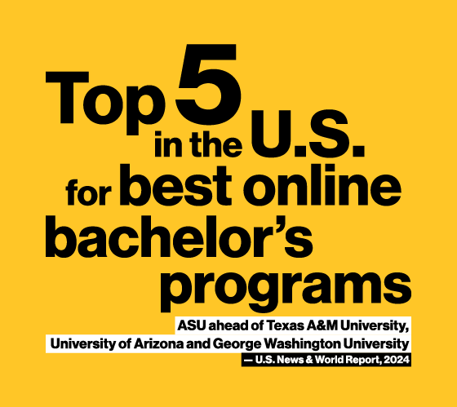
… measured not by whom it excludes but by whom it includes and how they succeed…
152,812 students from 180+ countries
48% students studying fully online
42% first in their family to attend college
34% of undergraduates receive Pell grants (exceptional financial need)
85% retention of first-year students
15,000 graduates of the ASU-Starbucks College Achievement Plan – full tuition coverage

Slide 7
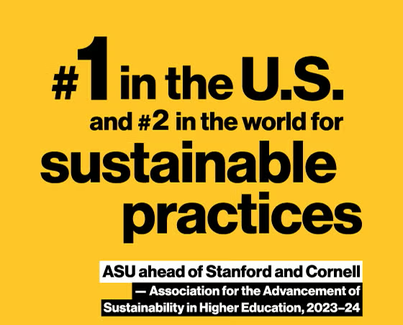
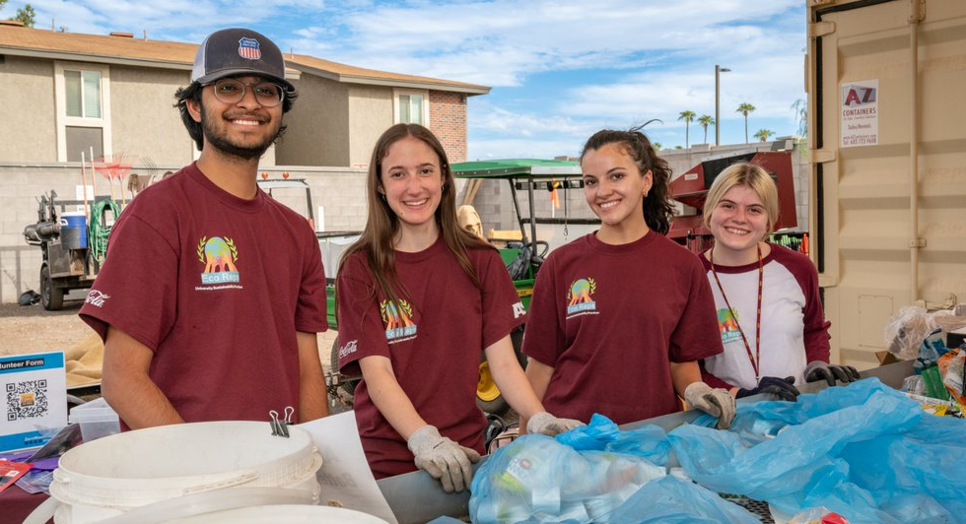
... and assuming fundamental responsibility for the economic, social, cultural and overall health of the communities it serves
Highly cultivated and consistent culture of risk, innovation, and optimism
2024: Sustainability adopted as a general studies requirement for all undergraduates
← University Sustainability Practices office

Slide 8
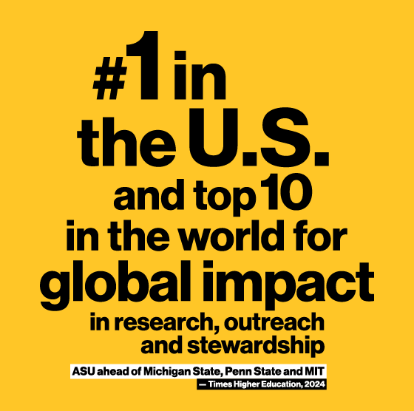
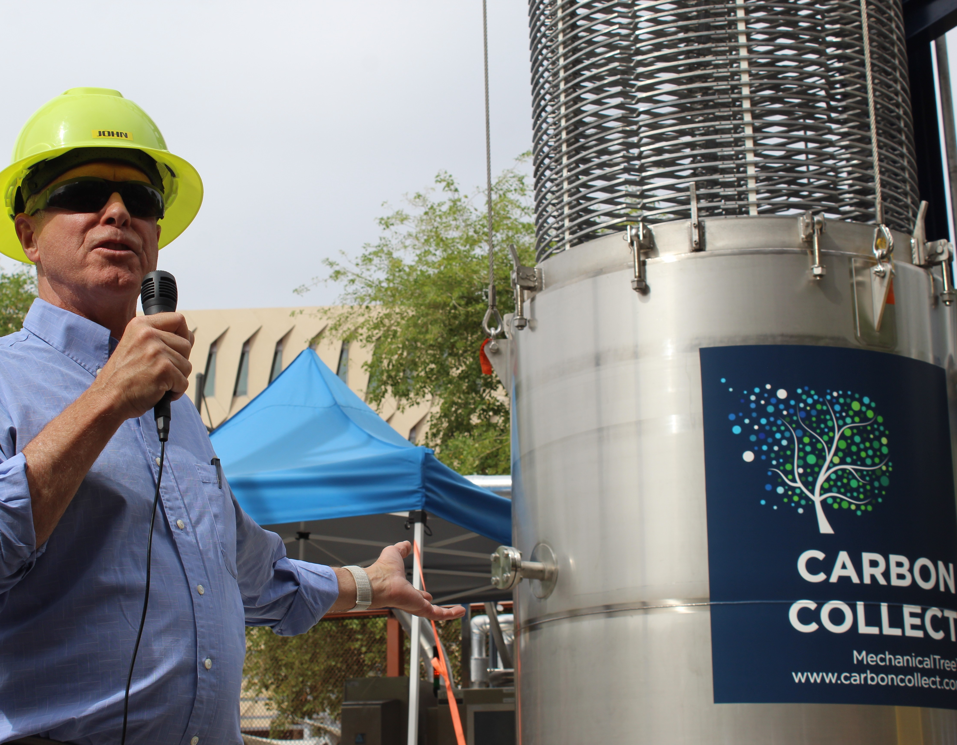
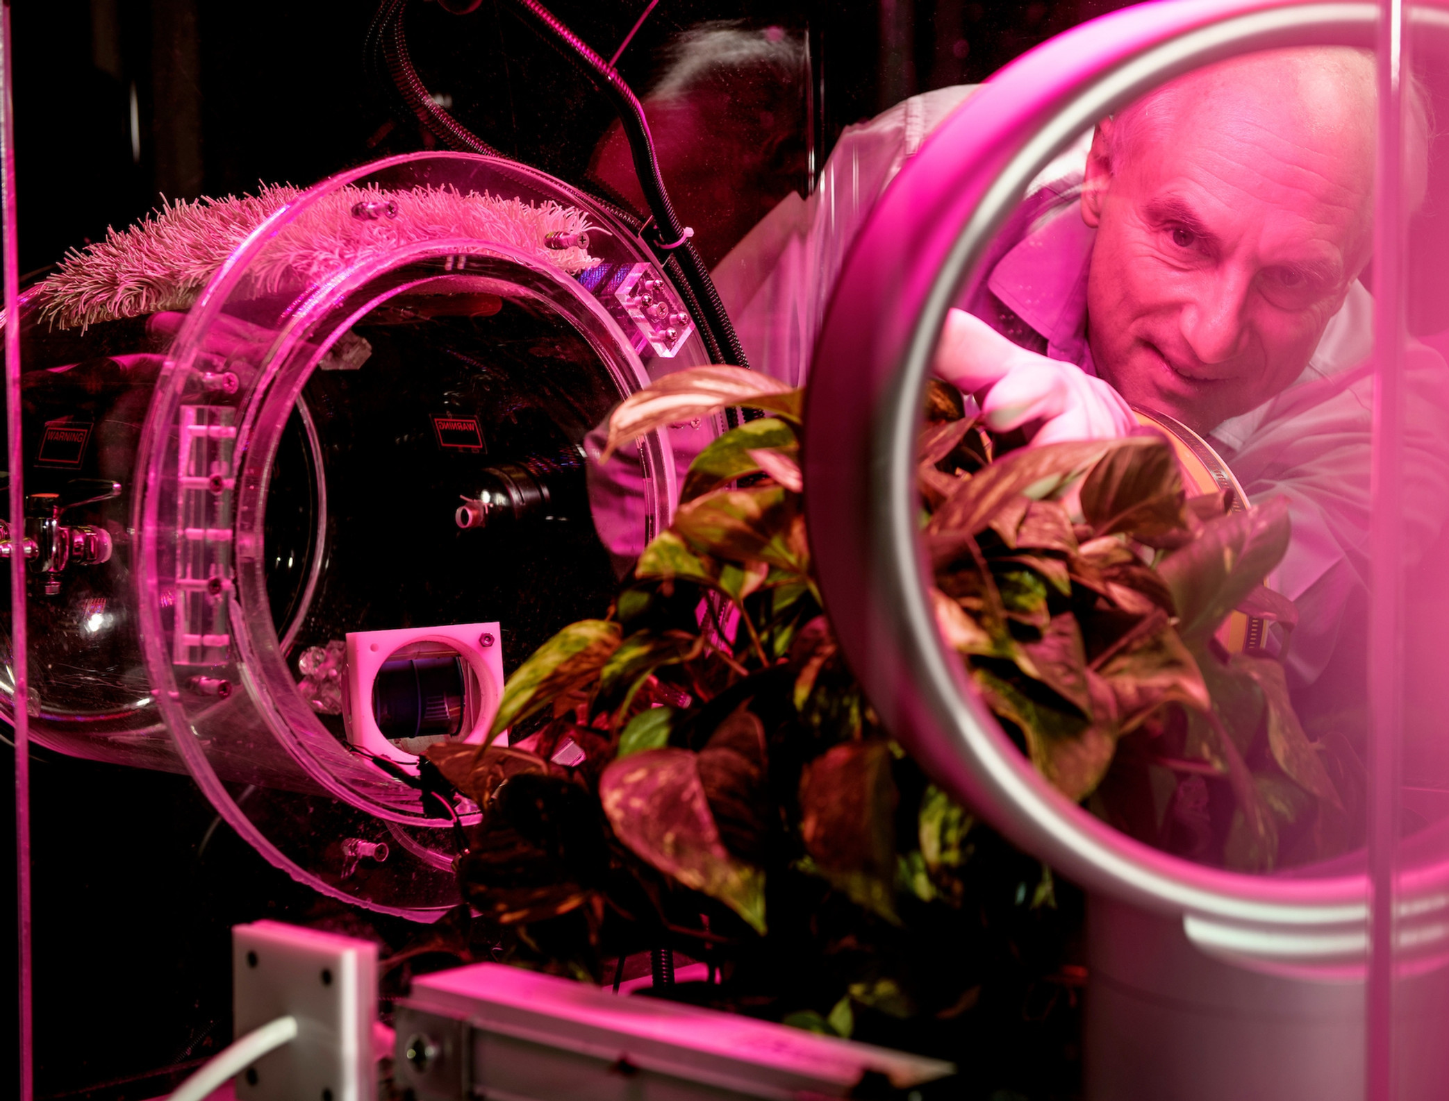
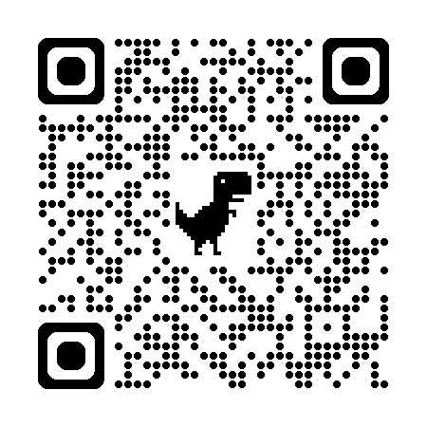
... and assuming fundamental responsibility for the economic, social, cultural and overall health of the communities it serves
ASU Center for Negative Carbon Emissions

Slide 9
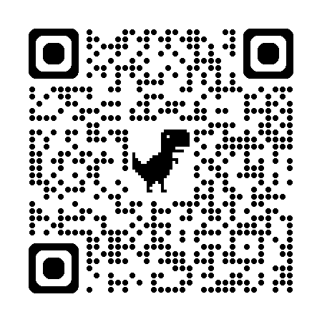
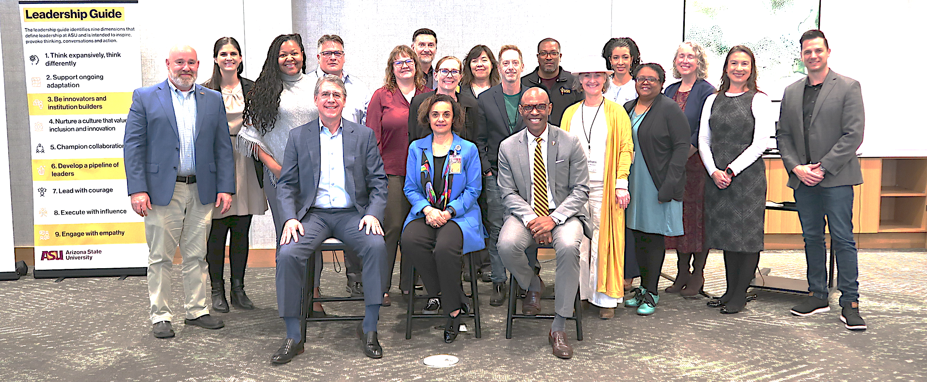
Building faculty as knowledge entrepreneurs
Formal faculty leadership training with industry best-practices
“At ASU University Design Institute™, our vision is for universities to emerge as powerful engines of social and economic impact.”
Intentional co-mingling of faculty and executive staff from industry
Flag bearers and leadership mentoring within your sphere – “everyone is a leader”

Slide 10

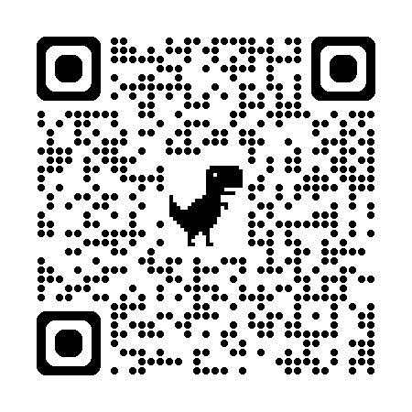
Adapting university structures for urgent societal needs
Knowledge Enterprise
RESEARCH & SOLUTIONS
Development of sandbox units as testbed. Interdisciplinary, participatory.
ASU
Global engagement and networks
Learning Enterprise
Centers and Institutes
Public/Private Partnerships
The Julie Ann Wrigley Global Futures Laboratory® will design implementable options to sustain global habitability and improve well-being for all humankind.
College of Global Futures
Solutions Service
Academic Enterprise

Slide 11
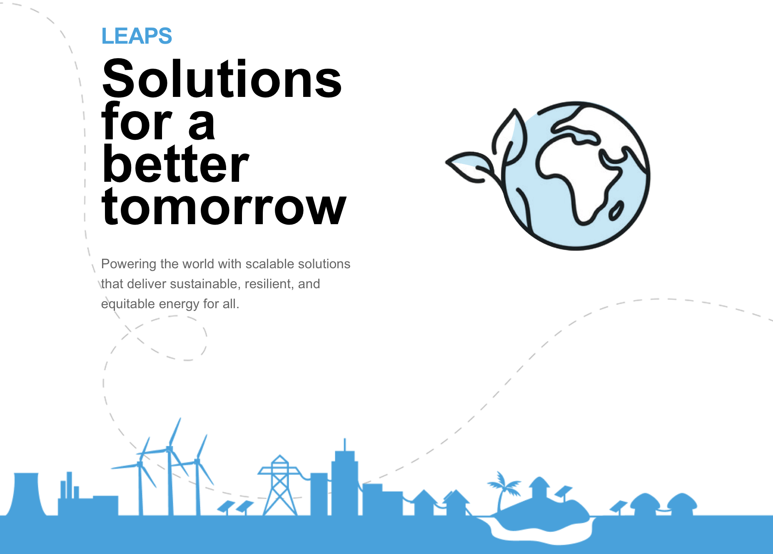
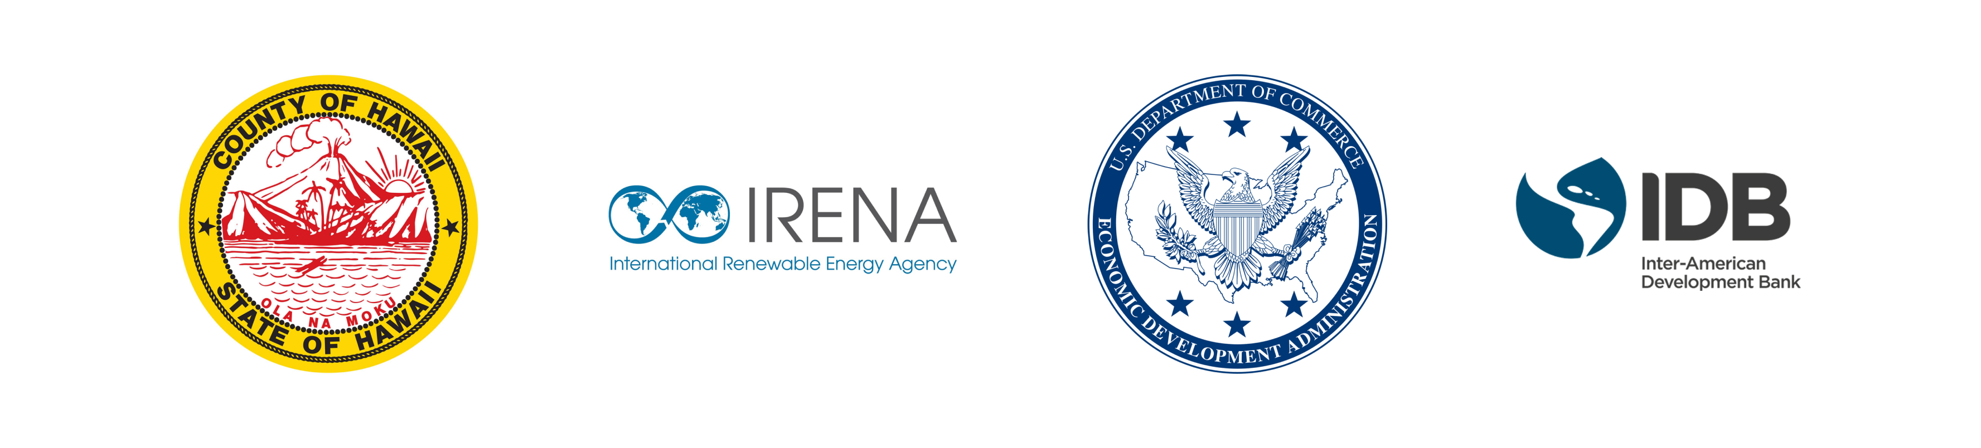
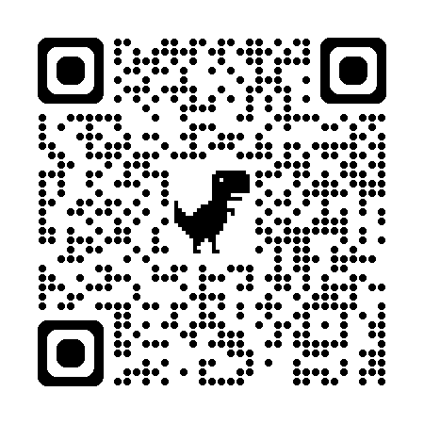
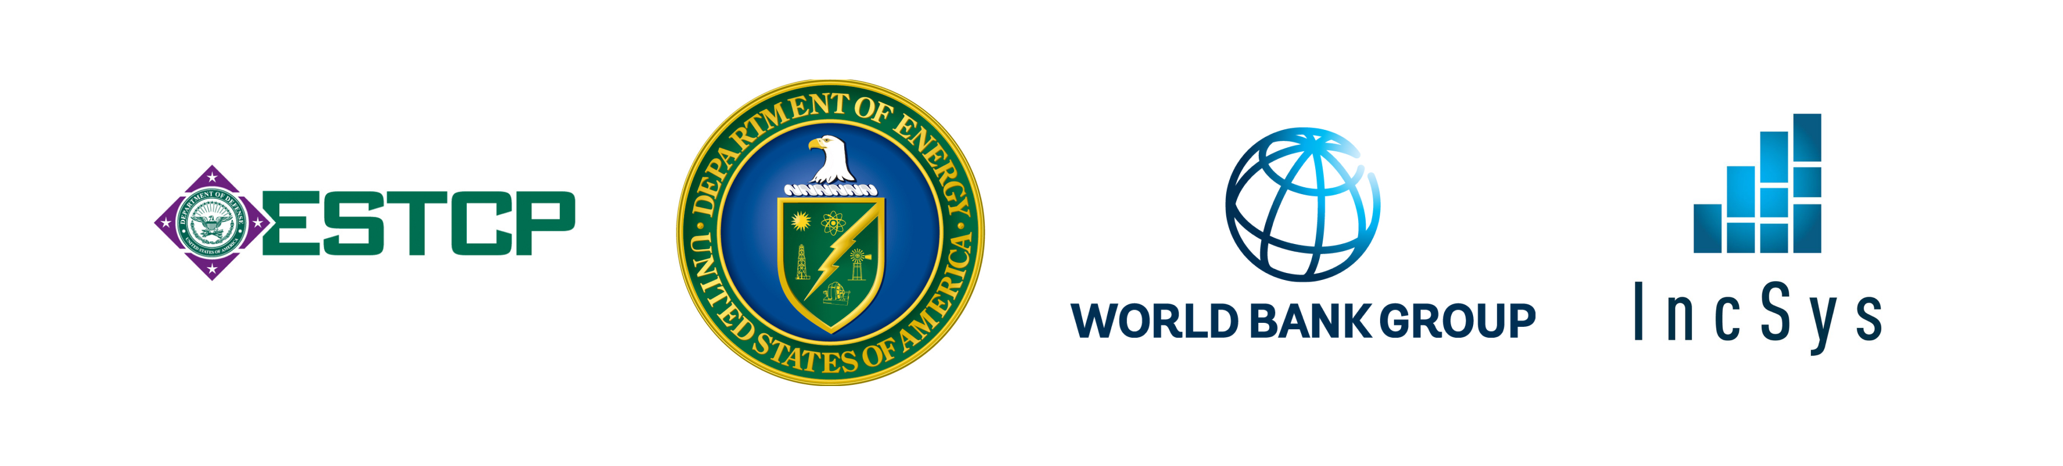
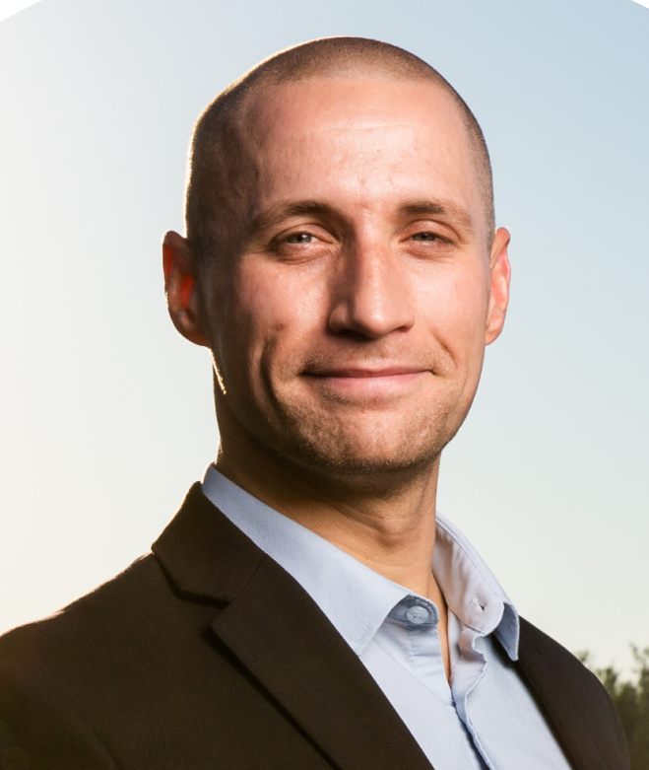

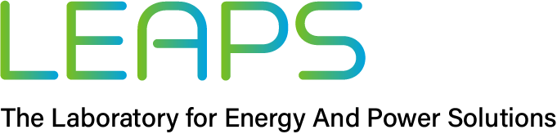
Adapting university structures for urgent societal needs
Investment in professional and executive support staff to facilitate solutions brokering with community partners
Powering the world with scalable solutions that deliver sustainable, resilient, and equitable energy for all.
Dr. Nathan Johnson

Slide 12
Creating a Process and Culture of Innovation
Problem Curation
Business
Academic
User stories
Business model canvas
Mission model canvas
SWOT analysis
Pilot testing
Commercial deployment
Innovation
Literature review
Scientific method
Basic science
Applied research
Prototypes/Experiments
Publication
Product
Process
People
Solution
Technology Delivery Service Cost/Financing Warranty Training

Slide 13
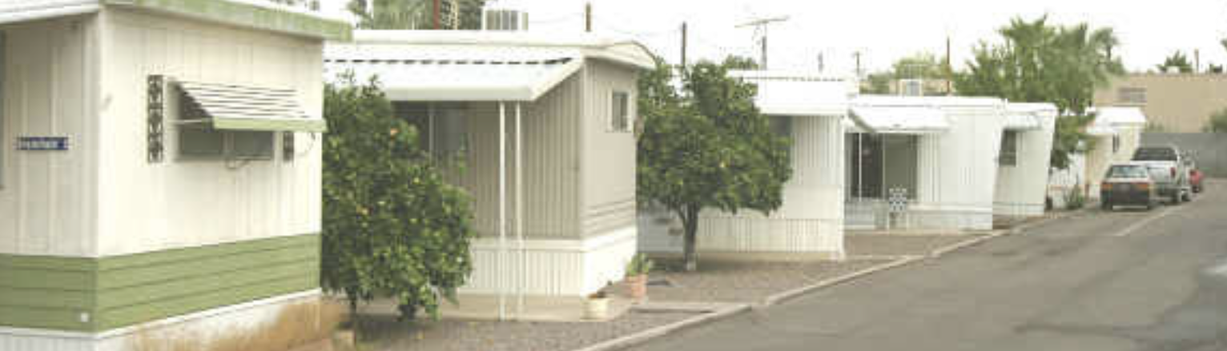
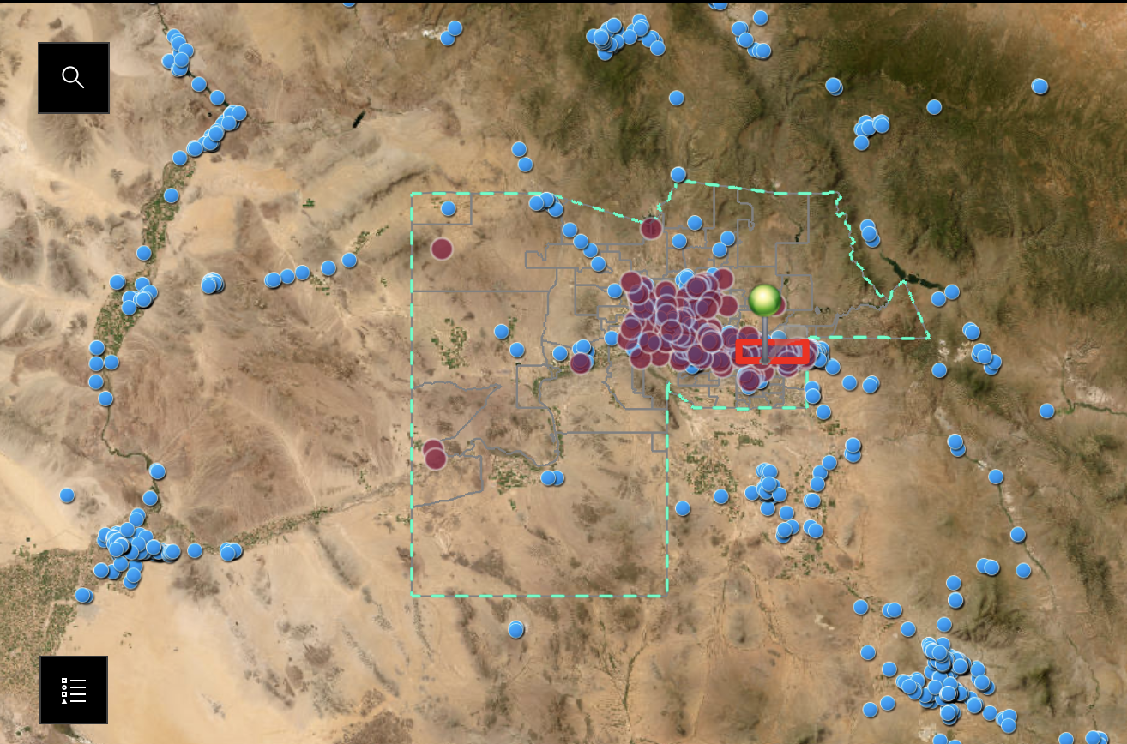
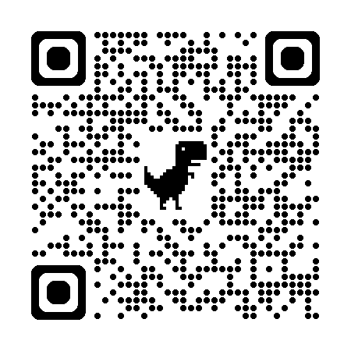
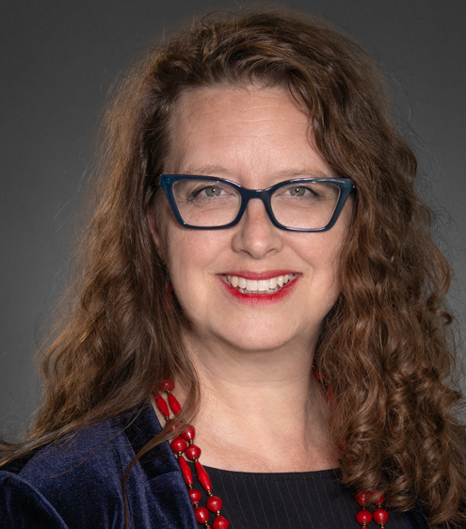
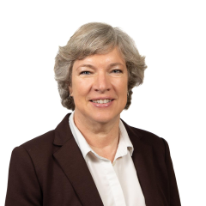
Adapting university structures for urgent societal needs
Investment and university support for promising, innovative ideas that lead to positive community impact
Knowledge Exchange for Resilience
Dr. Patricia Solís
Dr. Elizabeth Wentz

Slide 14
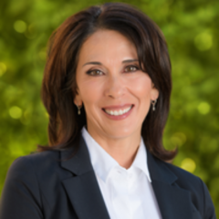
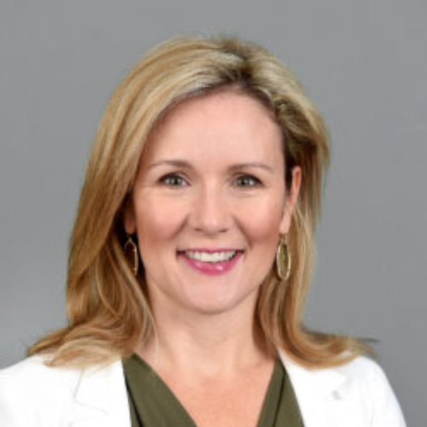
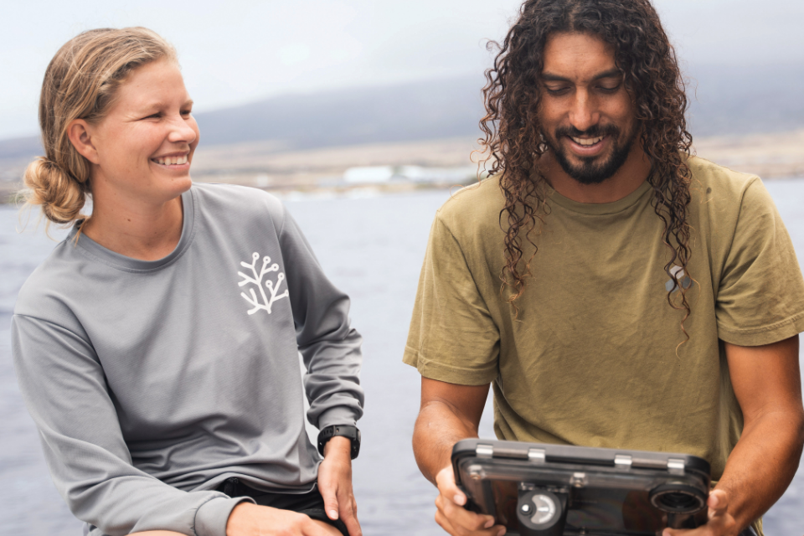
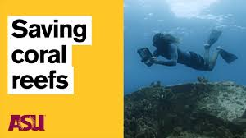
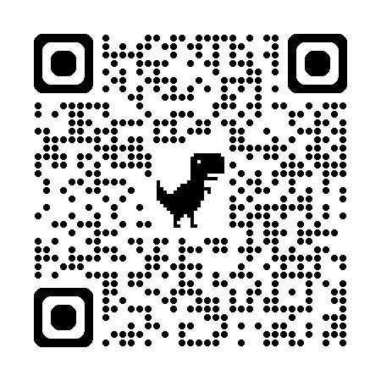
Adapting university structures for urgent societal needs
Review and revision of faculty promotion and tenure guidelines to reward community impact related to the university charter
Provost Nancy Gonzales
Dr. Miki Kittilson
Dr. Cliff Kapono
ASU School of Ocean Futures

Slide 15
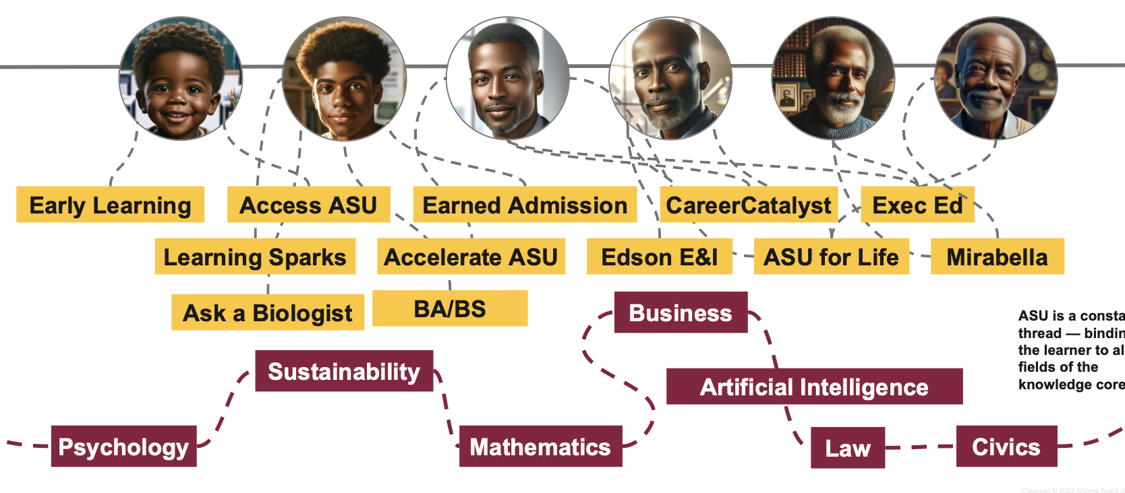
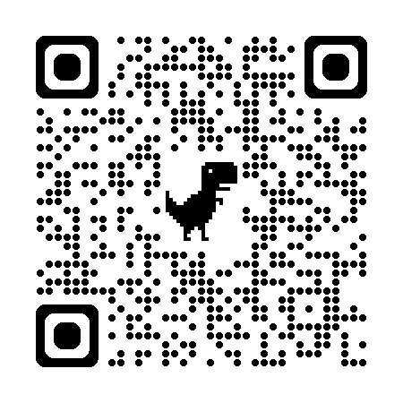
Adapting university structures for urgent societal needs
Flexible learning modalities to increase lifelong access and impact
in-person, online, hybrid, synchronous, asynchronous
ASU Learning Enterprise

Slide 16
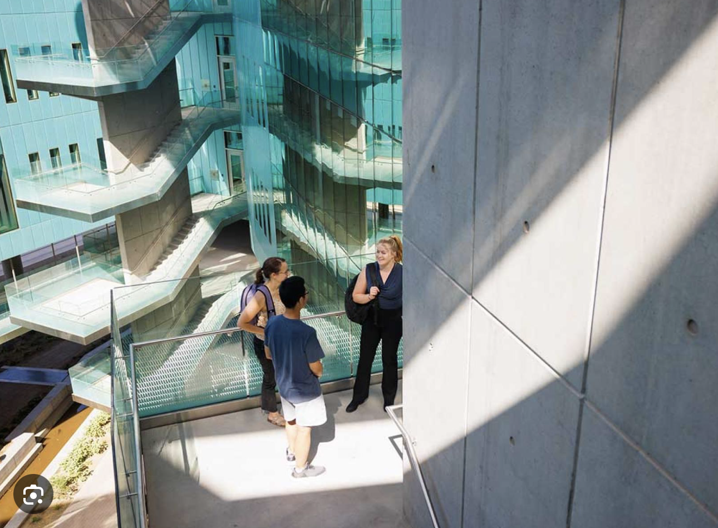
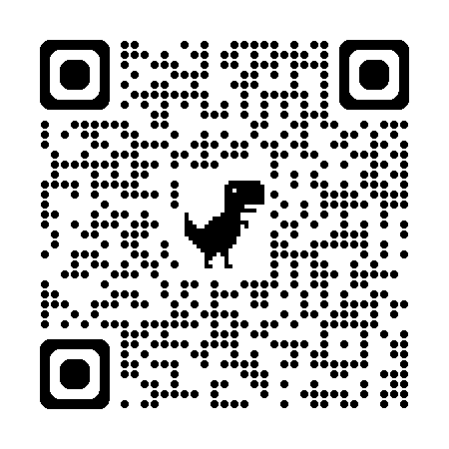
Rob & Melani Walton Center for Planetary Health at ASU
Next steps…
Share
Discuss
Learn
Collaborate
TRANSFORM
sharonjhall@asu.edu

